Slide 1


Haes budget FEEDBACK meeting
Thursday, February 25, 2021
4:15 PM

Slide 2
Budget overview total allocation: $8,383,982
The budget is based on student enrollment projections.
FY’21 – 605 projected enrollment
FY’22 – 606 projected enrollment
Teacher to scholar ratio
Projections
Grade Level | Enrollment
KDG | 81
1st | 91
2nd | 92
3rd | 110
4th | 122
5th | 110
Grade Level | Ratio
KDG | 1:25
1-3 | 1:26
4-5 | 1:30

Slide 3
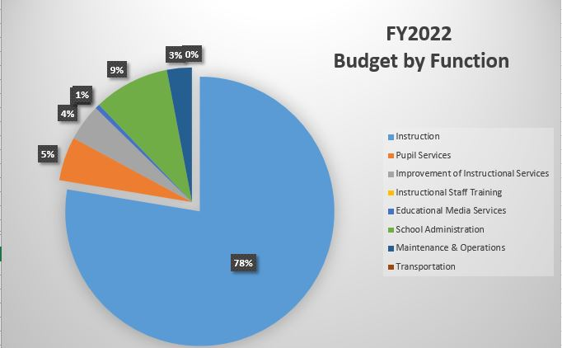
Budget allocations

Slide 4
Description
Staffing (salaries)
Materials & Supplies
Digital & Curriculum Resources
Equipment
Technology (We will not need much because we ordered in 2020-21)
Stipends (Professional Development, ILT, Grade Level Chairs, Lesson Planning)
Professional Development & Contractual Services (Leap Year, Out Teach, Hands On Atlanta, Vision Tutoring, Tutor Mate)
Family Engagement
Postage
Tutorial Transportation
HOW WE ALLOCATED
OUR MONEY

Slide 5
WrApAround support
SEL Coach (.5)
Psychologist (.5)
Counselors (2)
Social Worker (.4)
Nurse (2 part time)
RTI Specialist
School resource officer (.5)
Wrap Around Provider (New selection) – funded at district level

Slide 6
Staffing
Administration
Teachers
Instructional support
Non-instructional support
Parent liaison
STEM Program Specialist
Instructional specialist – reading and mathematics

Slide 7
New for 2021 - 2022
Replace bookkeeper position with secretary position
Addition of 5 Master Teacher Leaders
  increased feedback, additional support for induction and struggling teachers, personalized learning/Individual Learning Plans, teacher retention strategy
Addition of 1 full-time Art Teacher
Increase Band Teacher allocation from .25 to .50

Slide 8
POTENTIAL
CURRICULUM RESOURCES
Resources
STEMScopes Digital
iReady Reading & Math
Ready Reading & Math Workbooks
Social Studies Weekly Digital
Learning A-Z Reading Science
Flocabulary – purchased by APS
Brain Pop & Brain Pop, Jr.
Mastery Connect – maybe?
Write Score
Study Island
Moby Max
Fundations & Just Words
Ready Gen – purchased by APS
Georgia Science – purchased by APS

Slide 9
Questions & answers

